Slide 1

Strategies for Thesis Preparation and Submission in Engineering and Informatics
Prof. Alamgir Hossain
Director of Anglia Ruskin IT Research Institute

Slide 2

First Step
Have you got green signal from Supervisor? Time length – 3 months (minimum).
Divide the thesis into a number of distinct chapters
Each chapter (could be self-contained) normally divided into sections for clarity

Slide 3

Table of Contents
Title
Abstract
Acknowledgement
Table of Contents
List of Figures & Tables
Published Contribution (Abstract of the paper)
  Chapter 1. Introduction
  Chapter 2: Literature Review (1/2 chapter)
  Chapter 3: Theory/Methodology/Algorithms (1/2 chapter)
  Chapter 4: Simulation/Experiment (1/2 chapter)
  Chapter 5: Results & Discussion (1/2 chapter)
  Chapter 6: Conclusions & Future Research
  References
  Appendices
Note: complete 2 to 6 then 1 & others

Slide 4
Title
Put the keywords together and try to make a meaningful sentence
Should reflect the Thesis contents
* Your Turn (Try it now – 3 minutes)

Slide 5

Abstract
Describe BRIEFLY
  Purpose and nature of the project
  Experiments carried out
  Important results obtained and
  Contribution made (new/original)
Normally 300 words (maximum) in length

Slide 6
Acknowledgement
Acknowledge the support from supervisor(s), family, friends etc.
One page maximum

Slide 7
Table of Contents
Chapter One Page
  Introduction 1
    1.1 Background 2
    1.2 Aims & Objectives 3
    1.3 Guidance & Control 6
      1.3.2 Guidance 7
        1.3.2.1 Classification
    1.4 Control 14

Slide 8
List of Figures and Tables
List of Figures:
  Figure 3.1: Guided object .. 25
  Figure 3.2: Missile classification .. 29
  Figure 3.3: Skyguard missile .. 36
List of Tables:
  Table 1: An example of two parent chromosomes .. 63
  Table 2: Reproducing of chromosome using RCGA .. 63
  Table 3: Error convergence and execution time .. 84

Slide 9
Chapter 1: Introduction
Background –
  Importance / justification (area)
  Present the problem being studied and its context (may need references)
  Motivation
Aims & Objectives
Deliveries (?)
Outline of the Thesis

Slide 10
Chapter 2: Literature Review
Explore broader area then divide into
  Sub area 1
  Sub area 2
  Sub area 3 –
Interpret and draw conclusions about the current state of knowledge
Note: explore (with critical view) existing work and justify your aims & objectives

Slide 11
Chapter 3: Theory/Methodologies/Algorithms
What have you used/developed?
Have you modified any existing theory/methodology/algorithms? If yes, how?
Critical comparative analysis (if appropriate).
Note: for existing work (available in public domain) give appropriate references rather providing details

Slide 12
Chapter 4: Simulation/Experiment
What have you used?
  Theory/methodology/algorithms (refer previous chapter). Why?
  Software tools (provide features/scopes). Why?
  Resources (provide details). Why?
How did you implement it?
  Implementation details
  Parameters used
  Constraints in implementation
  Critical analysis (comparative features).

Slide 13
Results & Discussion
Often the most difficult chapter(s) of a thesis to write well !

Slide 14
Chapter 5: Results & discussion
Present results in meaningful form (not raw data) – Figures, Tables, Charts (as evidence)
Could be separated based on areas (refer to previous chapters) and sub areas
Provide illustration, possible theoretical or practical significance and critical analysis (opinion to justify) for figures/tables/charts
Provide comparative performance (each other/with existing work).

Slide 15

Tables and Figures
Insert number (in sequence) prefixed by the chapter number (eg Table 5.1, Figure 6.4)
Provide caption - a concise description of the material presented
Also note:
units clearly stated
graphs and histograms drawn with high quality graph-plotting packages
PC-drawn graphs should be checked carefully for anomalies and errors

Slide 16
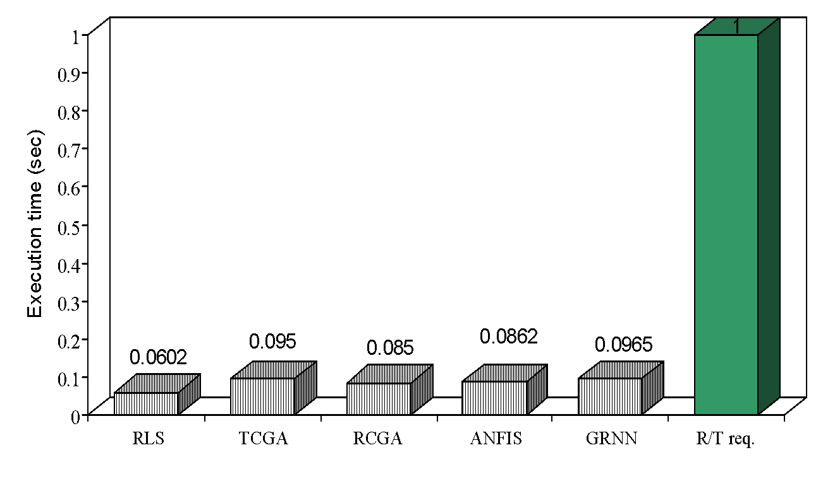
Chapter 5: Results & discussion (Example)
Algorithms
Figure 5.10: Execution time of the algorithms relative to the real-time requirement.

Slide 17
Chapter 6: Conclusions & Future Research
Discuss the previous chapters in the wider context of existing knowledge
Provide your critical view on achievement
List the main contributions clearly
Focus possible future research
  What is stimulated from your current research? What would do, if you have opportunity for further research? What are the possible research benefits it will bring?
  Provide a list (if appropriate).

Slide 18
References (Example)
Citation in Text:
The guidance and control laws used in earlier classical missiles are mainly based on classical control design techniques (Lin & SU 2000). In the 1950s, these control laws were developed and have evolved into fairly standard design procedures (Locke 1955). In 1981 Pastrick et al. (Pastrick et al. 1981) performed a survey of short-range terminal guidance laws developed up to 1979.
References:
Lin, C.F. and SU, H.W. (2000). "Intelligent Control Theory in Guidance and Control System Design an Overview", Proc Natl Sci Counc Repub China Part A Phys Scieng, Vol. 24(1), pp. 15-30.
Locke, A.S., (1955). Principles of Guided Missile Design: Guidance, New Jersey,USA, D. Van Nostrand Company, Princeton.
Pastrick, H.L., Seltzer, S.M. and Warren, M.E. (1981). "Guidance Laws for Short-Range Tactical Missiles", Journal of Guidance and Control, Vol. 4(2), pp. 98-108.

Slide 19

Acknowledging Others’ Work
Thesis MUST be your own work (Use Turn-It-In)
Where data is shared in co-operative projects, the source and extent of your own contribution should be indicated

Slide 20
Acknowledging Past Work
Past work provides the foundations on which we build new knowledge
Careful review of published work is therefore an important component of any good thesis
However, reproducing thoughts, views or results of other people without appropriate acknowledgement of the source is termed 'plagiarism' and constitutes a serious academic offence

Slide 21
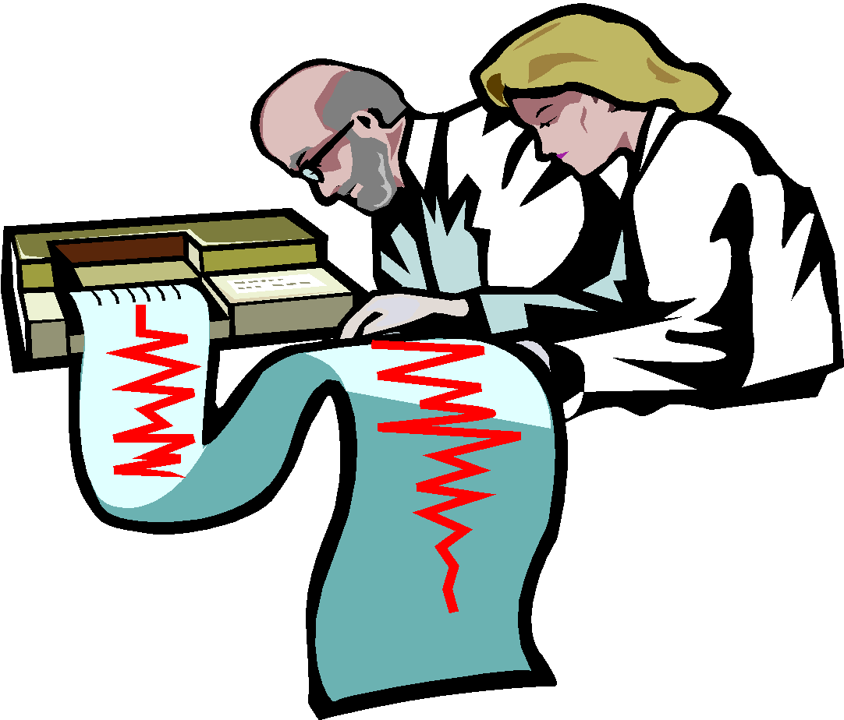
Appendices
‘Raw' data, if needed
Statistical analyses
  although details of the type of statistical analyses performed should be given in Methodology
Standard errors or standard deviations included in Figures and Tables where appropriate
Detail Mathematical derivation
Details of resources (hardware/software)
Source code (CD/DVD)

Slide 22

Tips
Your School/Dept web pages may offer guidelines for writing your PhD/MPhil thesis
Look at recent theses in the Library
Take advice from supervisor
Normally written in the Past tense and should be as concise as possible
Need for careful checking of spelling, grammar and punctuation, page number and references
Length: MPhil ~100-150 pages
Length: PhD ~ 150-300 pages
Remember - You are responsible

Slide 23
Good luck!
Questions?

